Slide 1

impact of environmental and seasonal factors on bike rental demand
GROUP 1
By: Abhishek Dubey, Aditi Tiwari, Aparna Mishra, Jayesh Saini, Jefferson Nguithi Kimani, Manmohan Dash, Neeti Mishra, Santhosh Sekar, Umang Singhal

Slide 2

Problem Statement
Research Question
How do environmental and seasonal factors impact bike rental demand?
Objective
Analyse environmental (e.g., temperature, humidity) and temporal (e.g., seasons, holidays) influences on usage to support better business planning.
Significance
Insights help bike-sharing and delivery businesses optimize operations and guide urban planning.

Slide 3
Literature Review
Previous Studies
Research has shown that temperature and precipitation are primary drivers of bike usage (e.g., Smith et al., 2018).
Seasonal patterns significantly affect daily bike rentals, with higher usage observed in summer and lower in winter (e.g., Johnson et al., 2019).
Contribution
Our study integrates environmental factors (temperature, humidity, wind speed) with seasonal attributes (holidays, working days) in a unified framework.
We aim to provide a comprehensive perspective on the combined effects of these variables.
We test model assumptions (linearity, homoscedasticity, etc.) to ensure reliable predictions and conclusions, setting our analysis apart in terms of rigor and reliability.

Slide 4
DATA Set STATISTICS
Dataset:
UCI Bike Sharing
Dataset Observations:
17,379 entries
Temporal Coverage:
Covers two years of data (2011–2012).
Seasonal Distribution:
Includes data on all seasons, holidays, and weekends for comprehensive analysis.
Environmental Variables:
Factors like temperature, humidity, and wind speed provide crucial insights into demand variation.
Attributes:
16 attributes, including temperature, humidity, wind speed, working day/holiday, and rental counts (hourly and daily).

Slide 5
SOLUTION WORKFLOW
Data Preparation
Exploratory Data Analysis
Regression Modelling
Hypothesis Testing
Time Series Analysis

Slide 6
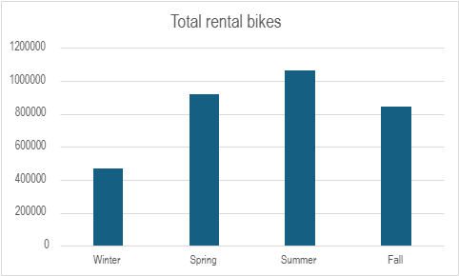
Exploratory data analysis
Highest Rentals in Summer (~1,100,000): Peak rental activity during summer due to ideal biking conditions.
Winter Sees Least Rentals (~450,000): Lowest rentals in winter due to colder weather and reduced biking interest.
Spring Rentals (~900,000): High demand in spring as weather becomes more favorable for outdoor activities.
Fall Rentals (~800,000): Moderate demand in fall as weather cools but remains conducive for biking.

Slide 7
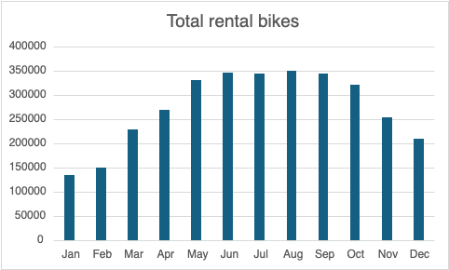
Exploratory data analysis (cont’d)
Peak Rentals (June to September ~400,000): Highest rentals due to favorable weather and increased outdoor activity.
Steady Increase (January ~150,000 to May ~300,000): Gradual rise in rentals as weather improves.
Decline After September (~350,000): Rentals drop as weather cools and outdoor activity decreases.
Lowest Rentals (January and February ~150,000): Lowest demand in winter due to cold weather and reduced biking interest.

Slide 8
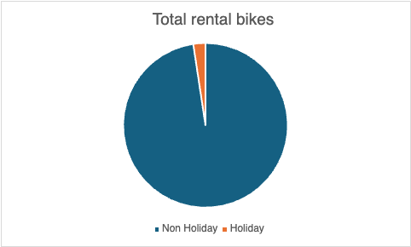
Exploratory data analysis (cont’d)
95% of Rentals on Non-Holiday Days: Most rentals happen on regular days, likely due to routine commuting or daily activities.
5% of Rentals on Holidays: Rentals are significantly lower on holidays, likely due to competing leisure activities or travel plans that reduce demand for bike rentals.

Slide 9
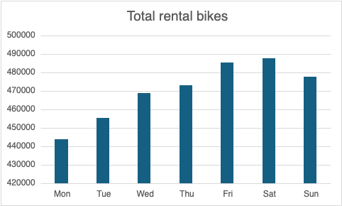
Exploratory data analysis (cont’d)
Highest Rentals on Saturday (~490,000): Peak rentals occur on Saturdays, likely due to weekend leisure activities.
Second-Highest Rentals on Friday (~480,000): Rentals are high on Fridays as people begin their weekend plans.
Sunday Rentals (~470,000): Slightly lower rentals on Sunday as the weekend winds down.
Lowest Rentals on Monday (~430,000): Rentals are lowest on Mondays, possibly due to the start of the workweek and reduced outdoor activity.

Slide 10
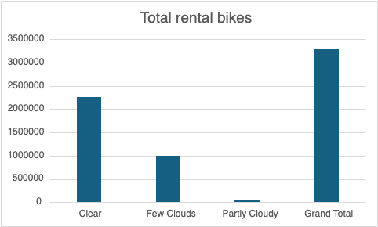
Exploratory data analysis (cont’d)
Clear Weather (~2.2M rentals): Highest rentals, indicating favorable biking conditions.
Few Clouds (~1M rentals): Moderate rentals, suggesting partial cloud cover is still suitable for biking.
Partly Cloudy (~100K rentals): Minimal rentals, indicating overcast conditions deter biking activity.
Grand Total (~3.5M rentals): Clear weather plays a significant role in driving total rentals.

Slide 11
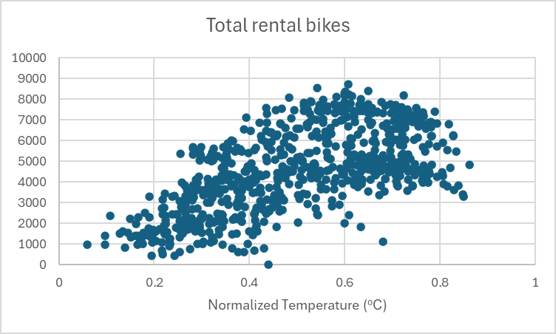
Exploratory data analysis (cont’d)
Peak Rentals in Moderate Temperatures: Biking rentals increase between 0.5 and 0.8 normalized temperature.
Low Rentals at Extremes: Minimal rentals observed at very low and high temperatures.
Temperature-Driven Demand: Moderate temperatures lead to higher biking activity, indicating seasonal trends.
Opportunity for Targeted Marketing: Align marketing efforts with optimal temperature ranges to boost rental demand.

Slide 12
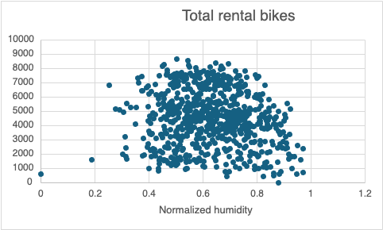
Exploratory data analysis (cont’d)
Trend: The scatterplot reveals a weak correlation between normalized humidity and total bike rentals, suggesting humidity alone may not significantly impact rental behavior.
Cluster: Bike rentals are most concentrated in the mid-range of normalized humidity (0.4–0.8), likely due to these conditions being more conducive to comfortable outdoor activity.
Outliers: Lower rental volumes at extreme humidity levels may indicate adverse weather conditions affecting user preferences.

Slide 13
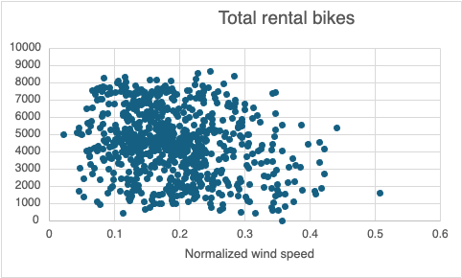
Exploratory data analysis (cont’d)
Trend: The scatterplot indicates a weak negative correlation between normalized wind speed and total bike rentals, as higher wind speeds appear to coincide with fewer rentals.
Cluster: Most bike rentals occur at lower wind speeds (0.1–0.3), likely because calmer conditions are more favorable for cycling.
Outliers: Few rentals at higher wind speeds (above 0.4) could indicate reduced demand due to less favorable cycling conditions.

Slide 14
Empirical methods
Exploratory Data Analysis :Conducted descriptive statistics (mean, median, variance) to summarize the dataset. Visualized trends and relationships using scatter plots, histograms, and heatmaps to understand variable distributions and correlations.
Inferential Statistics : Applied correlation analysis to measure the strength of relationships between variables (e.g., temperature and bike rental demand).
Multiple Linear Regression Analysis: Used OLS (Ordinary Least Squares) regression to estimate the impact of independent variables (e.g., temperature, humidity, wind speed) on the dependent variable (bike rentals).
Assumption Testing: Verified model assumptions, including:
Linearity: Checked if relationships between predictors and the response variable are linear.
Homoscedasticity: Assessed constant variance of residuals using residual plots.
Normality of Residuals: Ensured residuals follow a normal distribution.
Multicollinearity: Measured variance inflation factors (VIF) to detect correlated predictors.

Slide 15
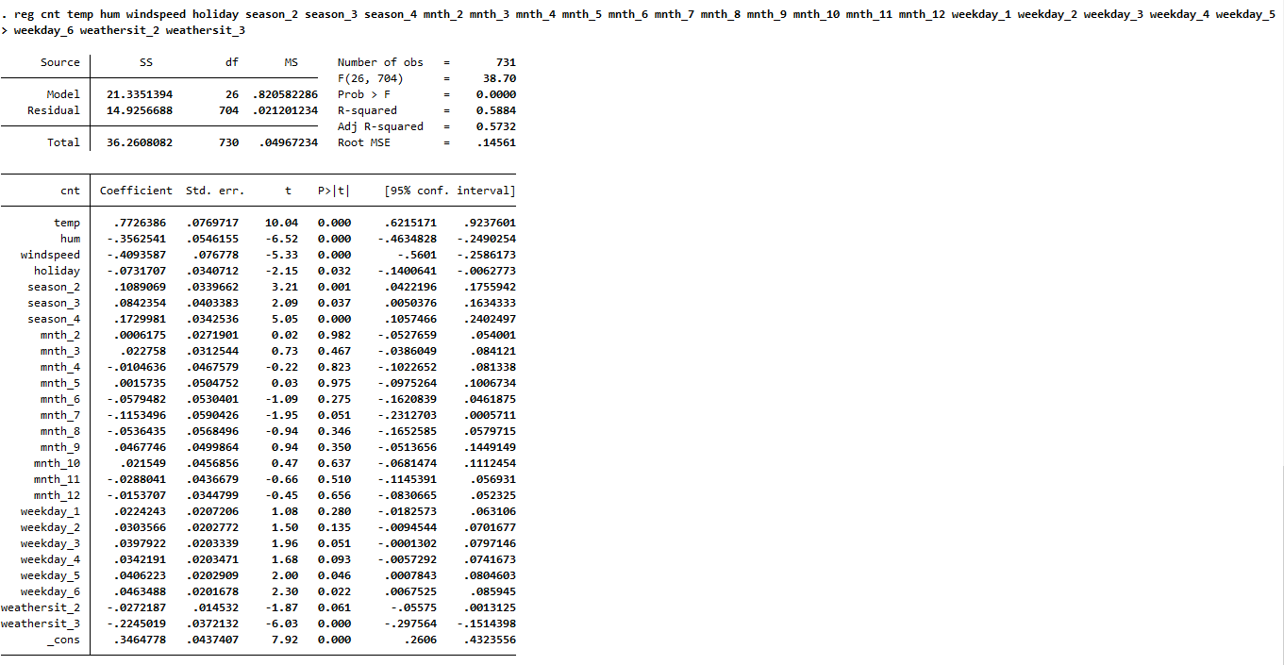
Multiple linear regression INSIGHTS
Temperature (-0.1747) has a strong, positive relationship with bike rental demand, as expected—warmer weather generally increases outdoor activities.
Humidity (-0.3366) has a negative impact, meaning that higher humidity discourages rentals, likely because it makes biking less comfortable.
These coefficients reflect seasonal biking patterns. Spring (0.1023) and summer (0.0957) increase demand as weather conditions improve, while winter (-0.1817) reduces it.
Months like May (mnth_5) and August (mnth_8) show positive coefficients (0.0832 and 0.0564, respectively) and are statistically significant, consistent with higher demand during peak warm months.
Specific weekday effects align with expected patterns of demand fluctuating with workdays versus weekends.
Less favorable weather (weathersit_2, weathersit_3) conditions have negative coefficients suggesting that even worse weather (e.g., heavy rain) further reduces demand.

Slide 16
Key Insights
Environmental Factors: Temperature, humidity, and windspeed all have the expected impact on rentals, being significant and intuitive in direction. Temperature encourages biking, while humidity and wind deter it.
Seasonal and Monthly Effects: These coefficients also follow expected patterns, with positive effects in spring/summer and peak months like May and August, and negative effects in winter.
Weather Situations: Adverse weather conditions reduce demand, which aligns with real-world behavior. Conducive mid-range temperatures attract more customers to avail bike rides.
Notes:
Demand for bike rides decreases when the weather conditions are not conducive to driving, possibly leading to higher chances of bike accidents.
Demand reduces when the weather is Extreme hot/cold

Slide 17
Business Recommendations
Test out demand for alternatives (cars, unmanned car rides (like Waymo)) during adverse weather conditions to retain customers at a cheaper cost than existing competitive services (such as Uber, Waymo)
Try to optimize the availability of bikes (increasing the number of bike stations) to cater to short-distance demands (less than a mile or two) during adverse weather conditions
Provide proper winter wear with the bike to try to attract customers during winter and windy conditions

Slide 18
Thank You!☺ Questions?

